Slide 1
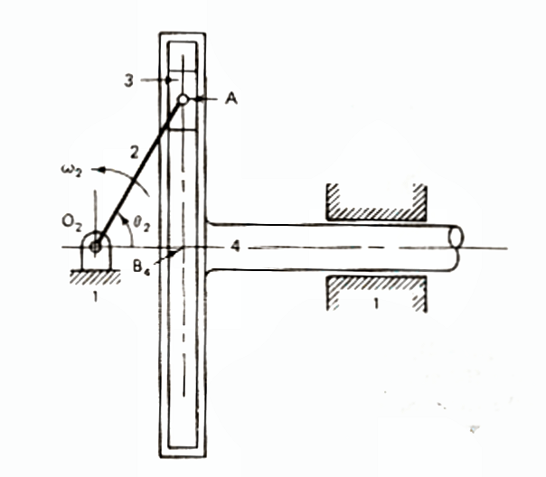
Velocity and acceleration analysis analysis using vectors
Problem 3
Link 2 rotates at a constant w₂ = 1 rad/sec.
θ₂ = 60º.
Find V_{A4} and a_{A4} if O₂A = 2.4 cm

Slide 2
Solution 3 : Velocity analysis for A
V_{A3A4} is along the slider in 4.
Only direction is known
V_{A3}= ω₂*O₂A
= 1 rad/s*2.4cm
=2.4 cm/s
Normal to O₂A
0
V_{A2}=V_{A3} +V_{A2A3}
= V_{A3}
= V_{A4}+V_{A3A4}
= V_{B4} +V_{B4A4} +V_{A3A4}
= V_{B4} +V_{A3A4}
V_{B4} is along the slider in 1.
Only direction is known
0
V_{A4} = V_{B4}
(since 4 is translating only, all points on 4 have same linear velocity)
A₃
V_{A3}= ω₂*O₂A
= 1 rad/s*2.4cm
=2.4 cm/s
V_{A3A4} = 1.2 cm/s
D, M=?
A₄
V_{A4}=2.08 cm/s
D, M=?
O_{v}

Slide 3
Solution 3 : Acceleration analysis for A
a_{A2} = a_{A3}
= a^{n}_{A2}+a^{t}_{A2} = a_{A4}+a^{s}_{A3A4} +a^{c}_{A3A4}
Here we observe a link 3 which slides relative to a moving link 4. Hence there should be a Coriolis term
a^{t}_{A2} = α₂*O₂A
=0*2.4=0
Hence
a_{A2} = a^{n}_{A2}
a^{Coriolis=ω}_{containing link*}V^{rel}_{contained link}
a^{C}_{A3A4} = 2ω₄* V_{A3A4}
a_{A4} = a_{B4} = ?
Along O₂B₄
But ω₄ = 0 as link 4 translates relative to the ground.
Hence a^{c}_{A3A4} = 0
a^{s}_{A4A3} =?
Along A₂B₄
a_{A2} = a^{n}_{A2}
= ω²₂*O₂A
=2.4 cm/s²
Radially inward from A to O₂
a_{A4} = 1.2 cm/sec²
D, M =?
A₄
O_{a}
a^{s}_{A3A4} = 2.08 cm/s²
D, M =?
a_{A3} = a_{A2} = a^{n}_{A2}
= 2.4 cm/sec²
A₃

